Slide 1
DeskGuard – Library Seat Booking & Anti-Hoarding System
Desk guard
Library seat booking and Anti-Hording System
Hackathon: WebForge
Name:Vaishnavi Vinod Bagal

Slide 2
Problem Statement and solution
Existing Problem
In libraries, students often reserve desks by leaving their bags and belongings while being absent for long periods. This creates unfair desk usage and prevents other students from accessing available study spaces. Currently, there is no efficient system to track desk occupancy and manage temporary absences.
Proposed Solution
DeskGuard is a smart library desk management system designed to ensure fair and efficient desk usage.
The system provides:
Real-time desk availability monitoring.
QR-code based desk check-in.
Temporary "Away Mode" for short breaks.
Automatic desk release after inactivity.
Librarian dashboard for monitoring and manual intervention.
DeskGuard helps maximize library utilization while preventing desk hoarding.

Slide 3
System Features
Real-Time Library Map
Displays desk status using color codes:
Green – Available
Red – Occupied
Yellow – Away
Gray – Abandoned
QR Code Check-In
Students can scan a QR code placed on the desk to begin their study session.
Away Mode
Students may temporarily leave their desk for a limited duration.
Session Monitoring
The system periodically confirms user presence and automatically frees abandoned desks.
Librarian Dashboard
Administrators can monitor desk usage and manually reset desks when necessary.

Slide 4
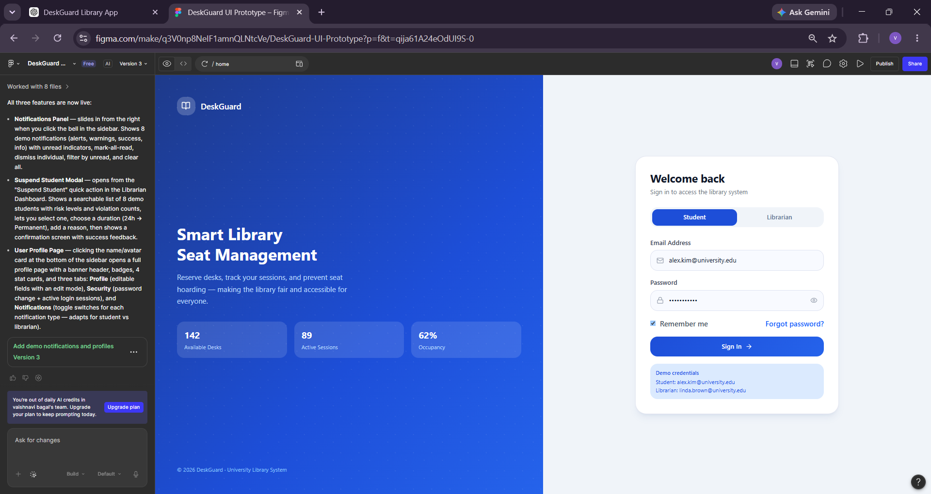
Screen 1 – Login Page
The Login Page allows students and librarians to securely access the DeskGuard system using their credentials.
Features
Email field
Password field
Login button
Forgot Password option
Register option
Purpose
Provides secure authentication for users and administrators.

Slide 5
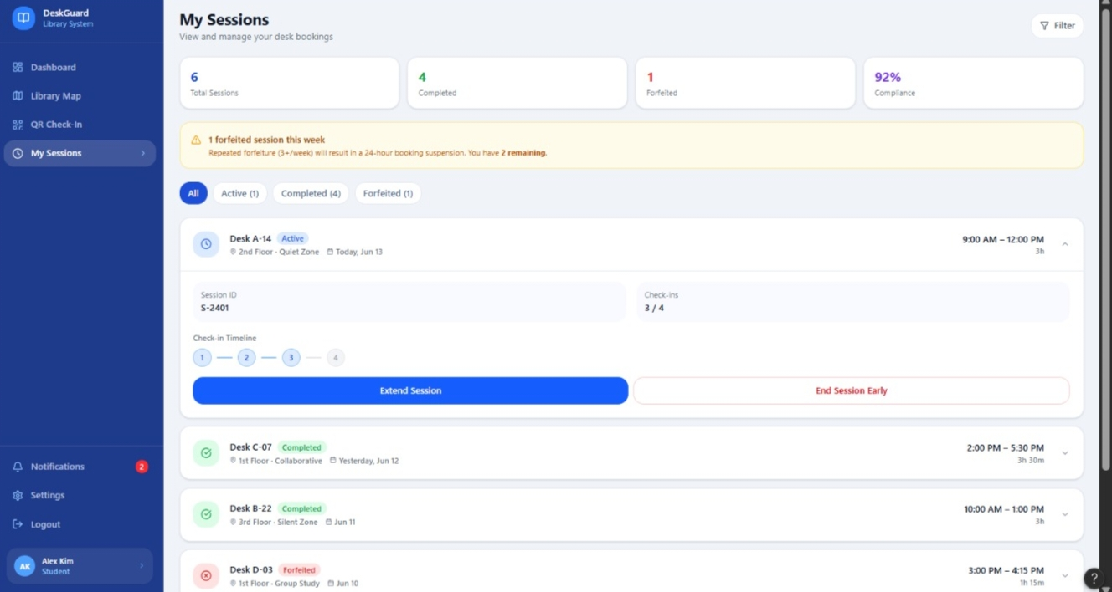
Screen 2 – Student Dashboard
Description
The Student Dashboard provides an overview of library desk statistics and quick access to important functions.
Features
Total Desks
Available Desks
Occupied Desks
Away Desks
Quick navigation options
Recent activity information
Purpose
Allows students to monitor desk availability and manage their sessions efficiently.

Slide 6
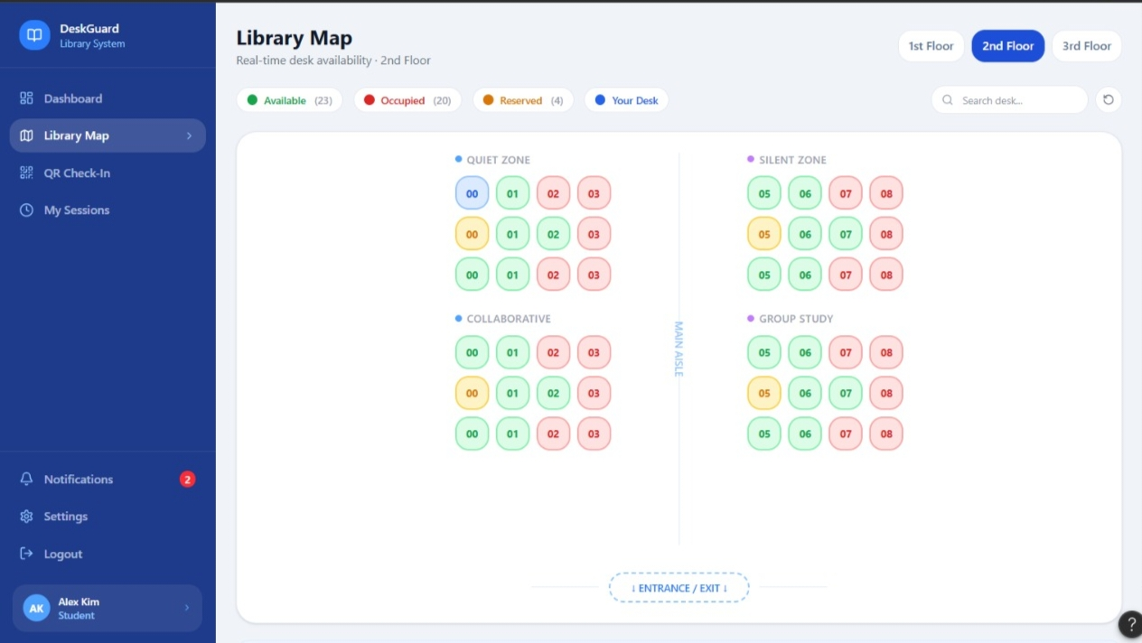
Screen 3 – Live Library Map
Description
The Live Library Map visually displays the status of every desk in the library.
Color Codes
Green – Available
Red – Occupied
Yellow – Away
Gray – Abandoned
Features
Interactive desk layout
Search functionality
Status filtering
Real-time visualization
Purpose
Enables students to quickly locate available study spaces.

Slide 7
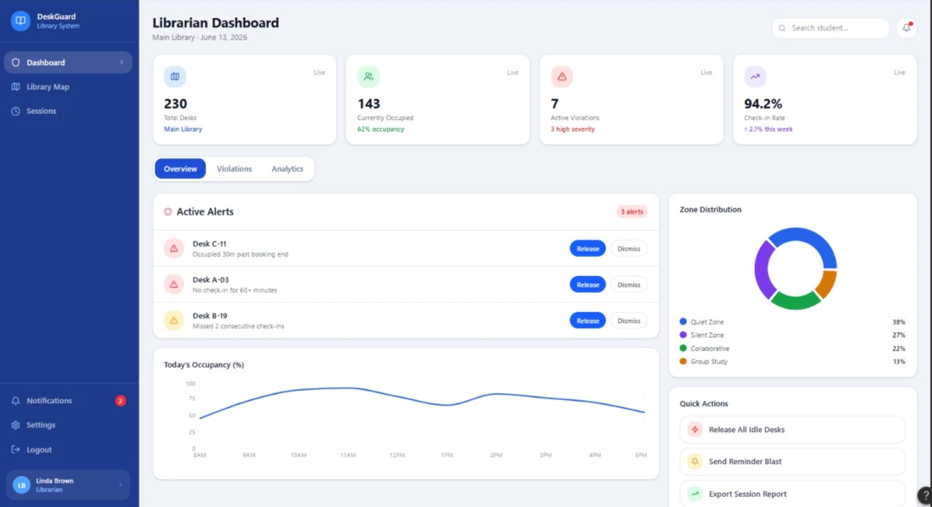
Screen 4 – librarian dashboard
Description
When a desk is selected, detailed information regarding that desk is displayed.
Features
Desk Number
Current Status
Occupant Information
Check-In Time
Session Duration
Occupy Button
Away Button
Release Button
Purpose
Allows librarian to manage desk sessions efficiently.

Slide 8
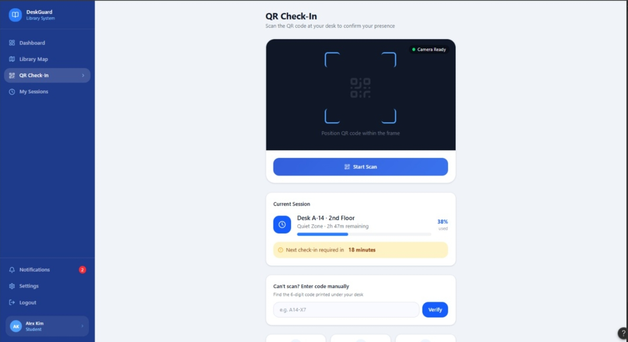
Screen 5 – QR Scanner Page
Description
Students can scan desk QR codes to start a study session.
Features
QR Scanner Interface
Scan Button
Desk Identification
Desk Availability Status
Purpose
Provides a quick and contactless desk reservation process.

Slide 9
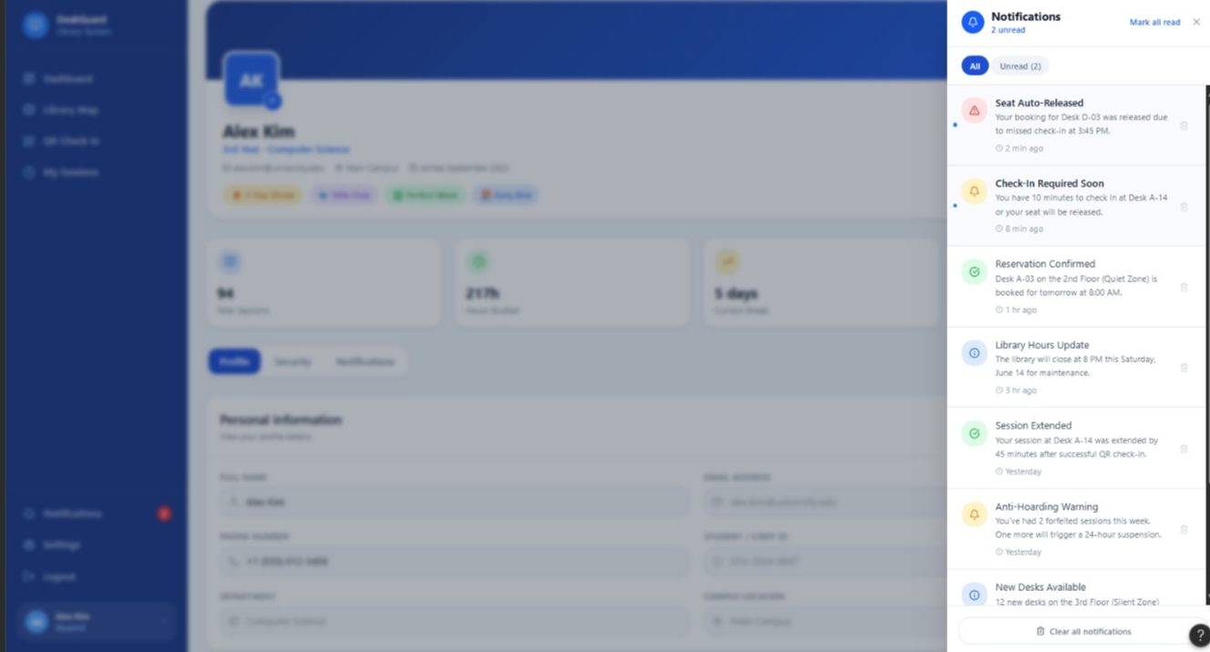
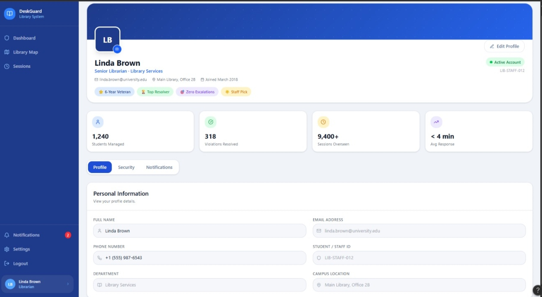

Slide 10
Advantages & Future Scope of DeskGuard
prevents desk hoarding.
Ensures fair seat allocation.
Improves library space utilization.
Provides real-time monitoring.
Reduces manual supervision effort.
Enhances student experience.
Supports efficient library management.
Future Scope
Mobile Application Support
AI-Based Crowd Prediction
Occupancy Analytics Dashboard
Email and Notification Alerts
Heatmap-Based Seat Usage Analysis
Integration with Student ID Cards
Prototype link
https://www.figma.com/make/q3V0np8NeIF1amnQLNtcVe/DeskGuard-UI-Prototype?t=qija61A24eOdUI9S-1

